Slide 1

Superclass Throwable
  Subclass Exception
    Exceptional situations
    Should be caught by program
  Subclass Error
    Typically not caught by program
    Program can’t usually recover from these
Checked exceptions
  Catch or declare
Unchecked exceptions

Slide 2
All exceptions inherit either directly or indirectly from class Exception
Exception classes form an inheritance hierarchy that can be extended

Slide 3
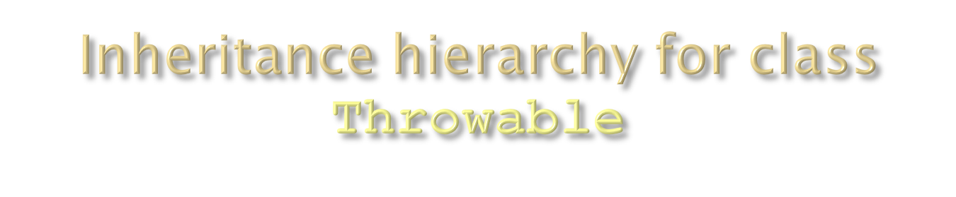
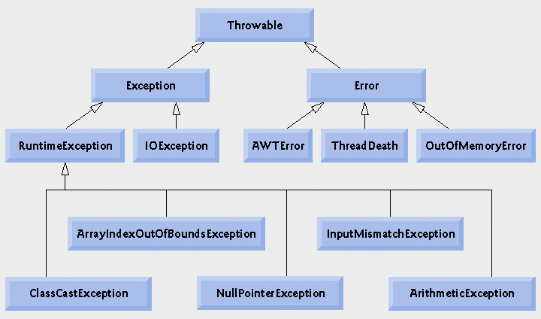

Slide 4

Inherit from class Exception but not from RuntimeException
Compiler enforces catch-or-declare requirement
Compiler checks each method call and method declaration
  determines whether method throws checked exceptions.
  If so, the compiler ensures checked exception caught or declared in throws clause.
  If not caught or declared, compiler error occurs.

Slide 5
IOExceptions are checked exceptions:
EOFException
  Reaches the EOF unexpectedly.
FileNotFoundException
MalformedURLException
  Not a valid URL
UnknownHostException
  The IP address of a host could not be determined

Slide 6

Inherit from RuntimeException class or Error class
Raised implicitly by system because of illegal execution of program
Created by Java System automatically

Slide 7

Error hierarchy describes internal errors and resource exhaustion.
Don’t throw an object of this type!
Notify the user and try to terminate gracefully
Relatively rare
Mostly beyond programmers control

Slide 8
“If it’s a RuntimeException it’s your fault!”
Can typically be prevented by proper coding
Compiler does not check code to see if exception caught or declared
If an unchecked exception occurs and is not caught the program terminates

Slide 9
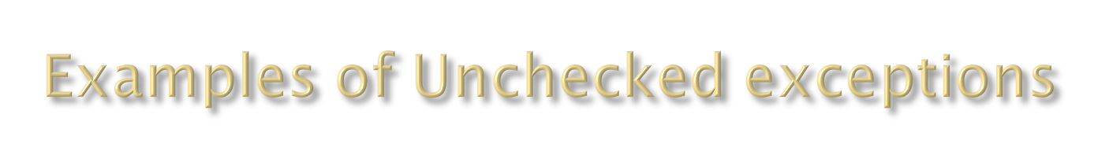
IndexOutOfBoundsException :
  When beyond the bound of index in the object which use index, such as array, string, and vector
ArrayStoreException :
  When assign object of incorrect type to element of array
NegativeArraySizeException :
  When using a negative size of array
NullPointerException :
When refer to object as a null pointer
ClassCastException:
  When attempting to cast an object to a subclass of which it is not an instance

